Slide 1
Computer-aided Risk Scores for mortality (CARM) and Sepsis (CARS) Work in Progress
24th July 2018

Slide 2
Research & Project Team
Statistics
Muhammad Faisal (UoB)
Andy Scally (UoB)
Qualitative research
Judith Dyson (UoH)
Patient & Public Involvement
Claire Marsh (BIHR)
Project Management
Natalie Jackson (IA)
Clinical lead
Donald Richardson (York)
Principal Investigator
Mohammed A Mohammed (UoB & BIHR)
Site specific clinical leads
Donald Richardson (York)
Kevin Speed (NLAG)
Richard Blythe (NLAG)
Site specific project leads
Jeremy Daws (NLAG)
Chris Foster (York)
Site specific IT leads
Robin Howes (NLAG)
Kevin Beaton (York)
Supported by the Health Foundation & NIHR PSTRC
2

Slide 3
Overview
Acute Medical Admissions (adult)
Two automated risk scores
Mortality
Sepsis
Routinely collected data
Vital signs (NEWS)
Blood test results + AKI
Age+sex
Field testing/piloting

Slide 5
Proposal
For each emergency medical patient
Automatically Compute
risk of mortality (CARM)
risk of sepsis (CARS)
Using
Equation based on NEWS (no bloods)
If blood test results available, then use equation based on NEWS + Bloods

Slide 6
Context
Acute hospitals
York Teaching Hospital NHS Foundation Trust
Northern Lincolnshire & Goole (NLAG) NHS Foundation Trust
Electronic NEWS
Focus
Emergency medical & elderly admissions

Slide 7
Methods
Adult general medical acute admissions
24 months data (1st Jan 2014 to 31st Dec 2015) from two Hospitals (NLAG & York)
Developed two risk equations using the patient’s first electronically recorded vital signs and blood test results
Computer aided-risk score for Mortality (CARM)
Computer aided risk score for Sepsis (CARS)
search for all two-way interactions and incorporated those interactions which were statistically significant (p<0.001)

Slide 8
Data used to create risk scores
Sex
Age
eNEWS (electronic National Early Warning Score including subcomponents + diastolic BP)
AKI stage
Albumin
Creatinine
Haemoglobin
Potassium
Sodium
Urea
White cell count

Slide 9
Inclusions/Exclusions
Characteristic | NLAG Hospital |  | York Hospital
 | N (%) | Died (%) | N (%) | Died (%)
Total emergency medical admissions 2 years (2014-15) | 37100 | 2004 (5.4) | 36751 | 1903 (5.2)
Excluded: No NEWS recorded (%) | 1305 (3.5) | 211 (16.2) | 772 (2.1) | 47 (6.1)
Excluded: First NEWS after 24 hours of admission (%) | 634 (1.7) | 48 (7.6) | 172 (0.5) | 8 (4.7)
Excluded: First blood test results after 4 days of admission (%) | 464 (1.3) | 27 (5.8) | 673 (1.8) | 55 (8.2)
Excluded: No blood test results recorded (%) | 3701 (10.0) | 103 (2.8) | 8887 (24.2) | 291 (3.3)
Total excluded (%) | 6104 (16.5) | 389 (6.4) | 10504 (28.6) | 401 (3.8)
Total included (%) | 30996 (83.5) | 1615 (5.2) | 26247 (71.4) | 1502 (5.7)

Slide 11
Internal & external validation
Each model was developed in one hospital and externally validated in the other hospital
We used bootstrapping method for Internal validation
Performance measures:
Discrimination relates to how well a model can separate, (or discriminate between), those who died and those who did not. C-statistic/ROC/Curve
Calibration relates to the agreement between observed mortality and predicted risk.

Slide 12
CARM Equation
y ~ -0.0841609392859383 + 0.272270268619721 * male + 0.0619014767187294 *
age - 0.0953372944281039 * ALB + 20.4152414034144 * log_CRE +
0.0030642496460944 * HB + 0.0795916591965259 * log_POT -
0.0107103276810239 * SOD + 1.049509623075 * log_WBC + 0.996715670424129 * log_URE + 1.44909779844291 * AKI1 + 1.91817976736971 * AKI2 + 0.60888289905878 * AKI3 + 0.0571939596024281 * NEWS + 0.642504494631563 * log_resp - 0.246217482730957 * temp + 0.176924987639937 * log_dias - 0.466876326689903 * log_syst + 0.426252285290785 * log_pulse - 0.022733748059009 * sat + 0.469824575364534 * sup + 1.27597597159774 * alert1 + 0.674577860317733 * alert2 + 1.75125534793613 * alert3 - 0.0081576508897676 * age_log_wbc -
1.30709428996164 * log_cre_log_wbc + 12.7544970609909 * aki3_log_cre
Not for human consumption!
but input variables are well known vital signs and blood tests

Slide 13
CARM AUC= 0.87 & 0.86

Slide 14
CARM - Sensitivity Analysis
Dataset | Cut-off | %Sens. | %Spec. | %PPV
Development dataset | 0.01 | 98.45 | 39.03 | 8.15
 | 0.02 | 95.79 | 55.76 | 10.64
 | 0.04 | 85.76 | 72.55 | 14.66
 | 0.08 | 70.34 | 85.64 | 21.22
 | 0.20 | 40.68 | 95.83 | 34.91
Validation dataset | 0.01 | 98.60 | 32.62 | 8.16
 | 0.02 | 95.74 | 49.63 | 10.34
 | 0.04 | 87.68 | 68.87 | 14.60
 | 0.08 | 71.04 | 84.03 | 21.26
 | 0.20 | 39.61 | 95.37 | 34.18
A cut-off value of 0.08 gives reasonable performance.

Slide 15
CARM vs NEWS vs Bloods

Slide 16
How well does CARM perform versus consultant medical staff in a head to head exercise?

Slide 17
Aim
To compare the performance of an automated validated computer aided risk score (CARM) versus medical judgment in predicting the risk of in-hospital mortality for patients following emergency medical admission.

Slide 18
Method
All elderly (>75yrs) acute medical admissions to the medical admissions unit will be assigned a risk of death score at the first post take ward round.
The same admissions were subsequently assigned a risk of death using the CARM score, based on age, sex, vital signs and blood test results.
The performance of the CARM versus medical judgement was compared using the area under the ROC curve (AUC)

Slide 19
AUC CARM 0.75 versus 0.72 medics
N=414: ~12% excluded no bloods
The in-hospital mortality was 31.7% (121/366).
Black line is for CARM and grey line is for medical judgement

Slide 20
CARS (Sepsis)

Slide 21
CARS Equation
y = -6.1564888437729 - 0.0270328634536142 * male + 0.0199064126536079 *
age + 0.0318604874833244 * ALB - 0.390237039770623 * log_CRE -
0.0162165566355658 * HB - 0.18225730563798 * log_POT - 0.0124282982105785 * SOD - 1.38934170685159 * log_WBC + 0.0778884119170707 * log_URE - 6.54645099936442 * AKI1 + 0.664397155908489 * AKI2 - 1.35603564469708 * AKI3 - 0.279580060385802 * NEWS + 0.461743818432309 * log_resp + 0.382149409017077 * temp + 0.010984460266291 * log_syst - 0.392841083038536 * log_dias + 0.439310262216449 * log_pulse - 0.0900770475307891 * sat + 0.265829549307129 * sup - 0.179963464841728 * alert1 + 0.124937390092917 * alert2 + 1.96201633139607 * alert3 + 0.0173727512982708 * hb_log_wbc - 0.0006999938721741 * alb_hb - 0.0387275823084831 * news_log_wbc + 0.0757822893425446 * aki1_sat - 0.545150038305524 * aki1_sup + 10.6897574739717 * aki3_log_cre + 0.0172156168794867 * age_aki3 + 0.0047228962409455 * news_sat - 0.256099754324944 * news_alert3

Slide 22
CARS AUC= 0.87 & 0.86

Slide 23
CARS - Sensitivity Analysis
Sepsis type | Cut-off | Development dataset |  |  |  | Validation dataset
 |  | %Prev. | %Sens. | %Spec. | %PPV | %Prev. | %Sens. | %Spec. | %PPV
All Sepsis | 0.05 | 18.52 | 97.74 | 20.63 | 21.87 | 25.08 | 99.06 | 11.29 | 27.21
 | 0.10 |  | 90.15 | 44.24 | 26.87 |  | 95.84 | 31.24 | 31.81
 | 0.20 |  | 67.76 | 73.15 | 36.45 |  | 83.24 | 59.85 | 40.97
 | 0.40 |  | 30.12 | 93.68 | 52.01 |  | 44.83 | 87.68 | 54.93
Sepsis | 0.05 | 13.24 | 97.12 | 19.42 | 15.53 | 15.84 | 98.57 | 10.06 | 17.10
 | 0.10 |  | 88.08 | 41.83 | 18.77 |  | 94.11 | 27.94 | 19.73
 | 0.20 |  | 63.70 | 70.03 | 24.49 |  | 79.08 | 54.34 | 24.58
 | 0.40 |  | 26.66 | 91.71 | 32.90 |  | 37.10 | 82.66 | 28.70
Severe Sepsis | 0.05 | 5.28 | 99.28 | 18.15 | 6.34 | 9.24 | 99.90 | 9.57 | 10.11
 | 0.10 |  | 95.31 | 39.73 | 8.11 |  | 98.81 | 26.82 | 12.08
 | 0.20 |  | 77.94 | 68.00 | 11.96 |  | 90.36 | 53.06 | 16.39
 | 0.40 |  | 38.79 | 90.84 | 19.11 |  | 58.10 | 83.36 | 26.23
A cut-off value of 0.20 gives reasonable performance.

Slide 24
Complex NEWS (cNEWS) for Mortality

Slide 25
Aim
We examine the extent to which the accuracy of NEWS for predicting mortality, could be improved by an enhanced, more complex, computer aided NEWS (cNEWS) model.

Slide 26
Method
All adult emergency medical admissions discharged over a 24-month period with electronically recorded NEWS on admission.
We developed four logistic regression models to predict the risk of death:
M0: NEWS alone
M1:NEWS + age + sex
M2:NEWS + age + sex + NEWS subcomponents + diastolic blood pressure
M3: NEWS + age + sex + NEWS subcomponents + diastolic blood pressure + two-way interactions.
We assess the performance of these models using the area under the ROC curve (AUC)

Slide 27
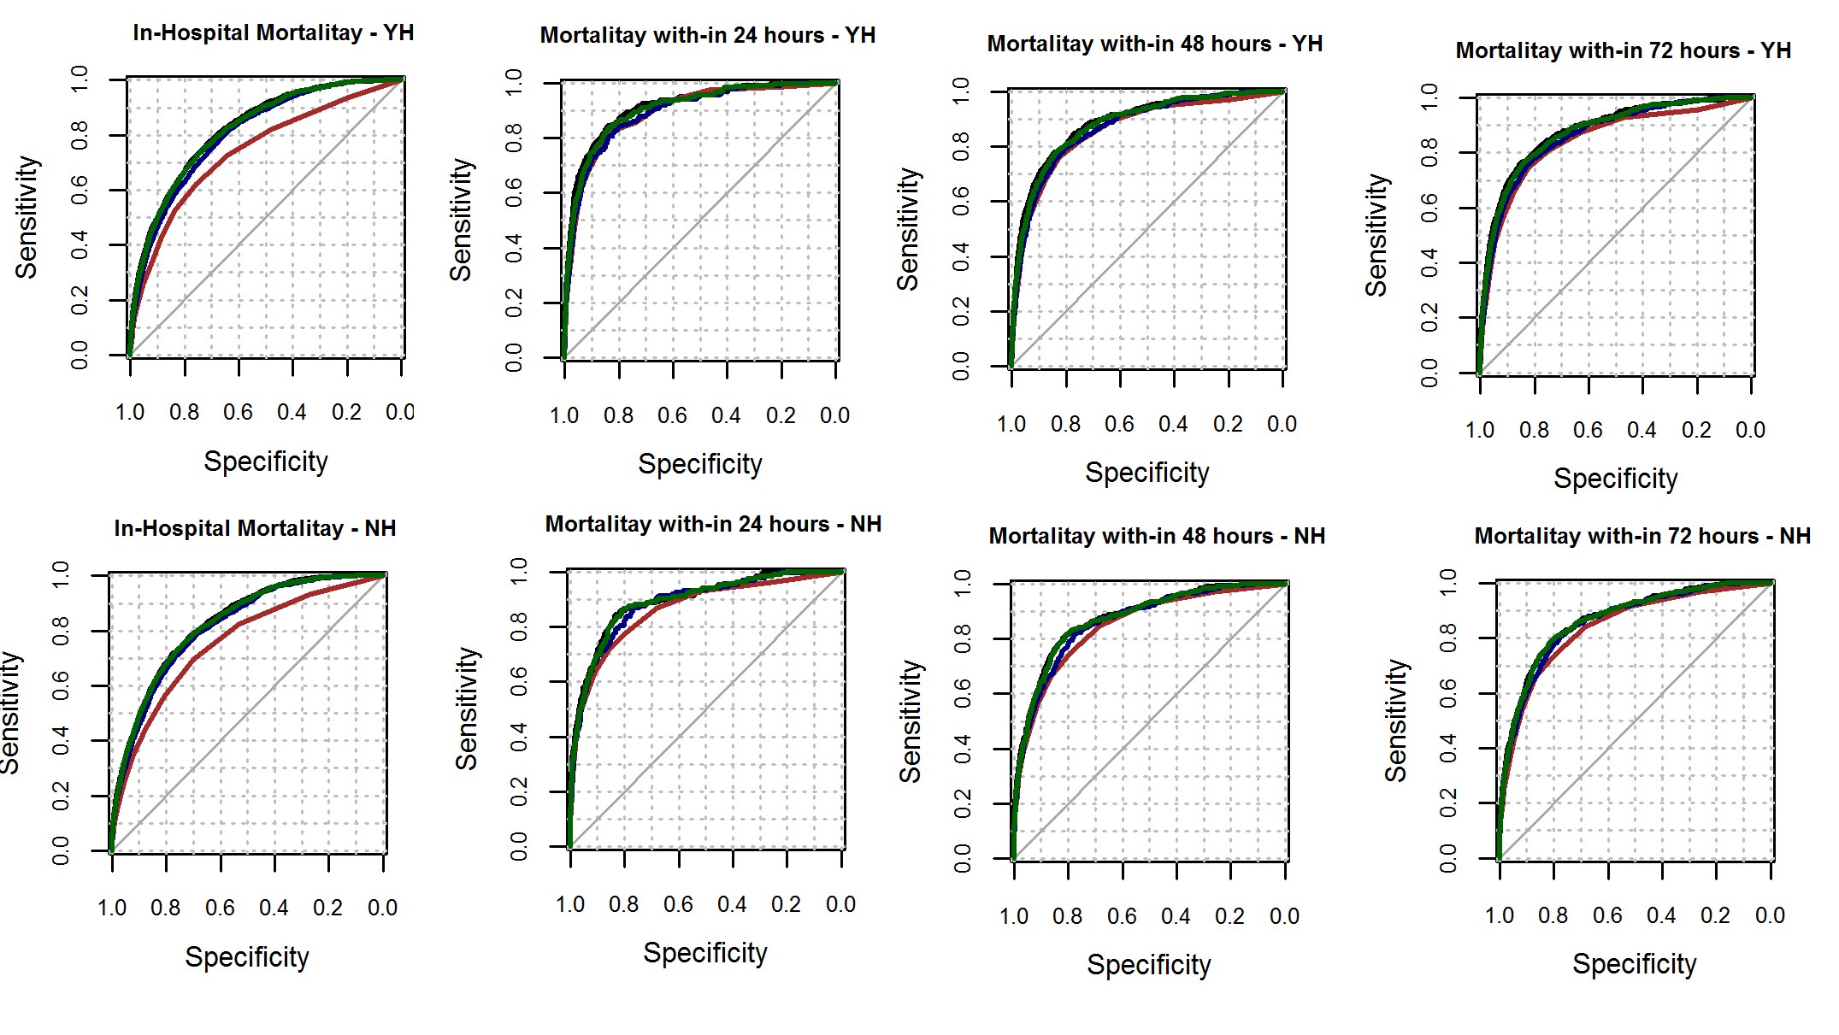
AUC
Red line is for NEWS only model (M0) and Blue line is for where NEWS adjusted by age and sex (M1). Green line is for where NEWS adjusted by age, sex, and NEWS subcomponents (M2) and Black line is for NEWS adjusted by age, sex, NEWS subcomponents, and interactions (M3).

Slide 28
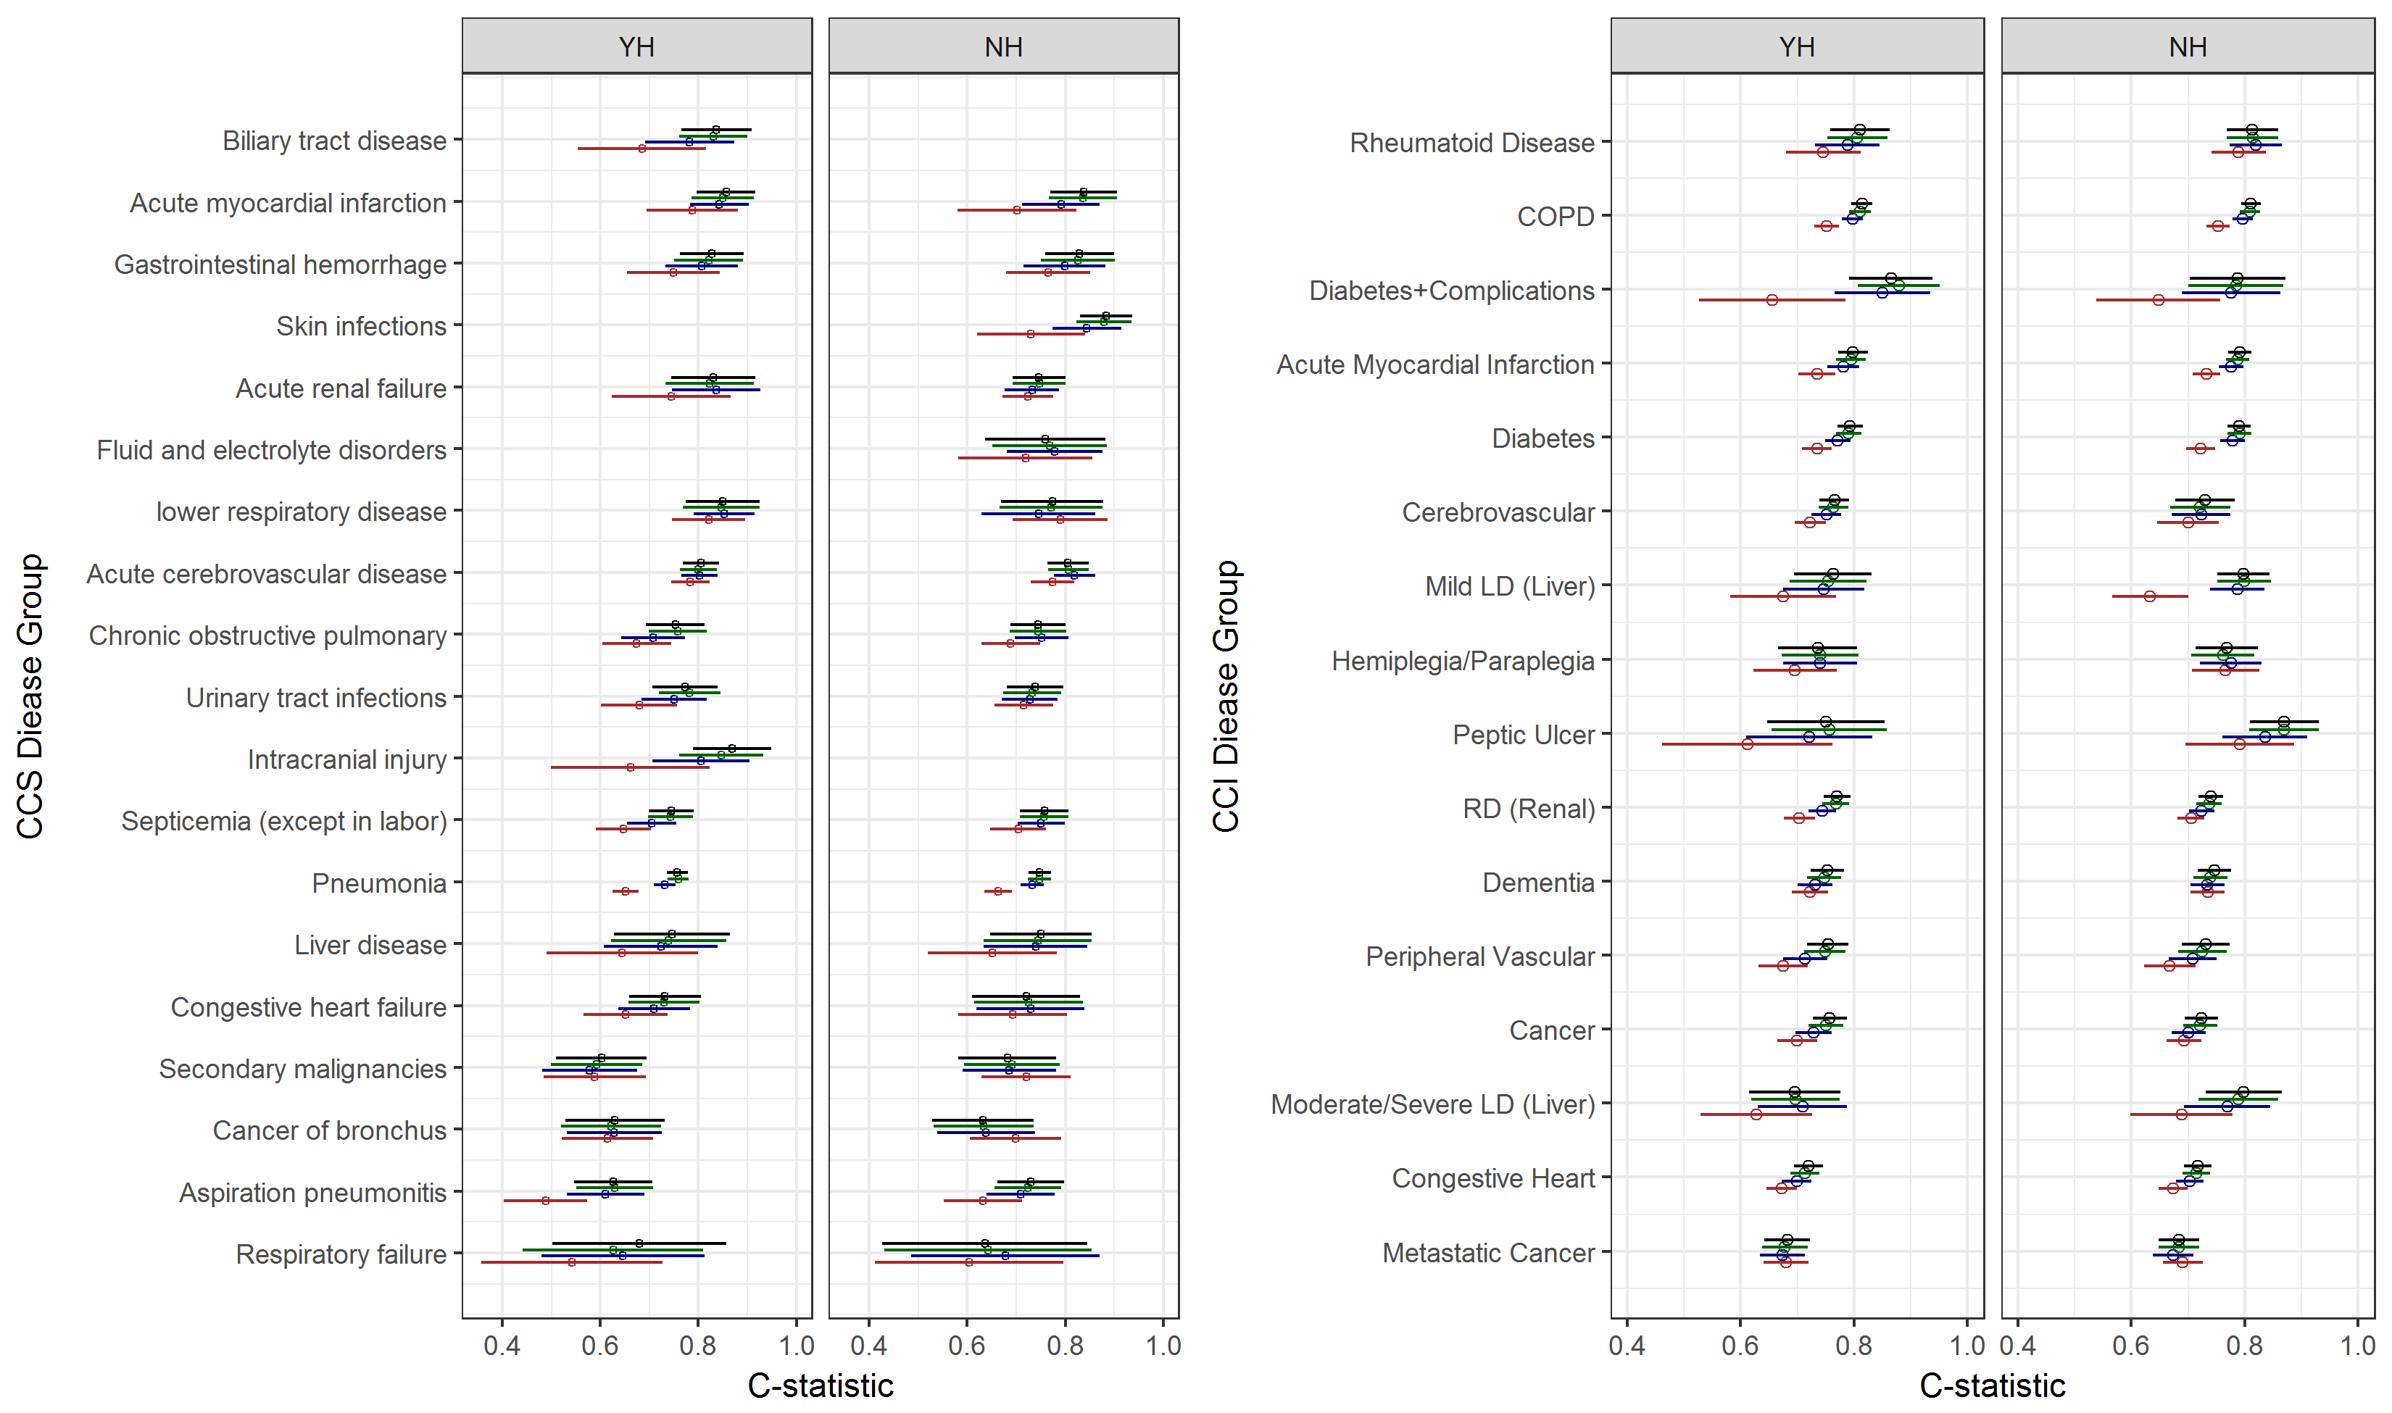
AUC in disease groups
Red line is for NEWS only model (M0) and Blue line is for where NEWS adjusted by age and sex (M1). Green line is for where NEWS adjusted by age, sex, and NEWS subcomponents (M2) and Black line is for NEWS adjusted by age, sex, NEWS subcomponents, and interactions (M3).

Slide 29
Complex NEWS (cNEWS) for Sepsis

Slide 30
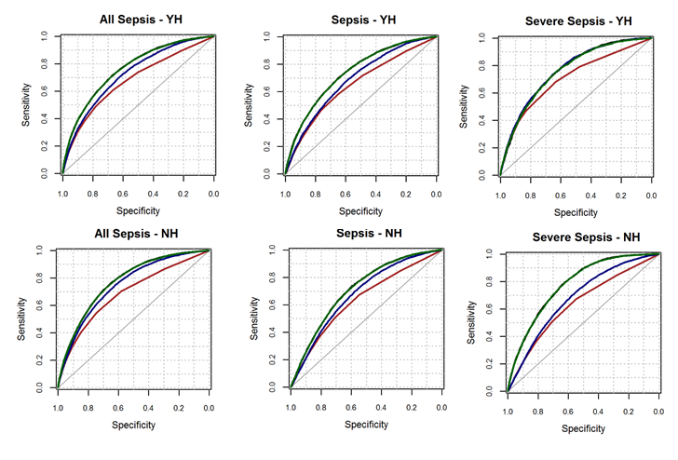
ROC – cNEWS Sepsis
Red line is for NEWS only model (M0) and Blue line is for where NEWS adjusted by age and sex (M1). Green line is for where NEWS adjusted by age, sex, and NEWS subcomponents (M2) and Black line is for NEWS adjusted by age, sex, NEWS subcomponents, and interactions (M3).

Slide 31
cNEWS Sepsis – Sensitivity analysis
Model | Outcome (Sepsis) | YH |  |  |  |  | NH
 |  | N | Sensitivity % | Specificity% | PPV | NPV | N | Sensitivity % | Specificity% | PPV | NPV
M0 | All Sepsis | 4697 | 38.3 (36.91 to 39.71) | 85.51 (84.47 to 86.5) | 34.21 (32.86 to 35.59) | 87.57 (86.59 to 88.5) | 3186 | 29.81 (28.22 to 31.43) | 90.66 (89.6 to 91.65) | 49.43 (47.68 to 51.18) | 80.83 (79.42 to 82.19)
M1 | All Sepsis | 6720 | 40.7 (39.52 to 41.89) | 85.51 (84.65 to 86.35) | 35.6 (34.46 to 36.76) | 87.99 (87.19 to 88.76) | 5498 | 33.76 (32.51 to 35.03) | 89.85 (89.03 to 90.64) | 50.47 (49.14 to 51.8) | 81.58 (80.53 to 82.6)
M2 | All Sepsis | 7366 | 48.14 (46.99 to 49.29) | 84.85 (84.01 to 85.66) | 38.47 (37.36 to 39.59) | 89.27 (88.54 to 89.96) | 6741 | 41.89 (40.71 to 43.08) | 87.79 (86.98 to 88.56) | 51.22 (50.02 to 52.42) | 83.15 (82.23 to 84.03)
M3 | All Sepsis | 8112 | 51.18 (50.09 to 52.27) | 82.95 (82.12 to 83.77) | 37.14 (36.09 to 38.2) | 89.62 (88.94 to 90.28) | 7622 | 46.12 (45 to 47.25) | 85.81 (85.01 to 86.58) | 49.88 (48.75 to 51.01) | 83.87 (83.03 to 84.69)
M0 | Sepsis | 4697 | 34.98 (33.62 to 36.36) | 83.85 (82.77 to 84.89) | 22.77 (21.58 to 24) | 90.45 (89.57 to 91.28) | 3186 | 25.21 (23.71 to 26.75) | 87.81 (86.62 to 88.93) | 26.67 (25.15 to 28.25) | 86.97 (85.75 to 88.12)
M1 | Sepsis | 6720 | 36.77 (35.62 to 37.94) | 83.65 (82.75 to 84.53) | 23.45 (22.44 to 24.48) | 90.67 (89.95 to 91.35) | 5498 | 28.33 (27.14 to 29.54) | 86.54 (85.61 to 87.43) | 27.02 (25.85 to 28.22) | 87.28 (86.37 to 88.15)
M2 | Sepsis | 7366 | 46.54 (45.39 to 47.69) | 82.96 (82.08 to 83.81) | 27.11 (26.09 to 28.14) | 91.93 (91.29 to 92.55) | 6741 | 37.76 (36.6 to 38.93) | 84.1 (83.2 to 84.96) | 29.46 (28.37 to 30.57) | 88.48 (87.69 to 89.23)
M3 | Sepsis | 8112 | 49.66 (48.57 to 50.76) | 81.02 (80.15 to 81.87) | 26.27 (25.31 to 27.24) | 92.2 (91.6 to 92.77) | 7622 | 41.98 (40.87 to 43.09) | 81.89 (81.01 to 82.75) | 28.97 (27.95 to 30) | 88.92 (88.19 to 89.61)
M0 | Severe Sepsis | 4697 | 47.24 (45.81 to 48.68) | 82.94 (81.83 to 84) | 11.44 (10.54 to 12.38) | 97.12 (96.6 to 97.58) | 3186 | 37.91 (36.23 to 39.63) | 88.07 (86.89 to 89.17) | 22.75 (21.31 to 24.25) | 93.87 (92.98 to 94.67)
M1 | Severe Sepsis | 6720 | 51.25 (50.05 to 52.45) | 82.72 (81.79 to 83.62) | 12.15 (11.38 to 12.96) | 97.32 (96.91 to 97.7) | 5498 | 43.35 (42.03 to 44.67) | 86.88 (85.96 to 87.76) | 23.45 (22.33 to 24.59) | 94.3 (93.65 to 94.9)
M2 | Severe Sepsis | 7366 | 52.44 (51.3 to 53.59) | 80.91 (80 to 81.8) | 11.36 (10.65 to 12.11) | 97.33 (96.94 to 97.69) | 6741 | 49.18 (47.98 to 50.38) | 83.61 (82.7 to 84.49) | 21.76 (20.78 to 22.77) | 94.67 (94.1 to 95.19)
M3 | Severe Sepsis | 8112 | 55.26 (54.17 to 56.35) | 78.86 (77.96 to 79.75) | 10.87 (10.2 to 11.57) | 97.42 (97.05 to 97.76) | 7622 | 53.44 (52.31 to 54.56) | 81.27 (80.37 to 82.14) | 20.91 (20 to 21.84) | 94.96 (94.44 to 95.44)
To predict the risk of all sepsis, sepsis, and severe sepsis at NEWS≥5 in the YH and NH hospitals

Slide 32
Proposal
For each emergency medical patient
Automatically Compute
risk of mortality (CARM)
risk of sepsis (CARS)
Using
Equation based on NEWS (no bloods)
If blood test results available, then use equation based on NEWS + Bloods

Slide 33
Next steps…
Small scale testing (PDSA cycles)
One team
One ward
Larger scale testing & Evaluation
Evaluation
Qualitative
Staff feedback
How has clinical decision making changed
??
Quant
Unplanned ICU admissions
Mortality
DNR orders/ceilings of are
Number and frequency of Blood tests
??
Randomly turn on/off the scores?

Slide 34
Questions/Issues
NEWS2
Field Testing

